Slide 1

Students Guide
Here is where your
journey begins

Slide 2
During the 4 weeks of “la piscine”, determination and stamina made it possible for you to surpass your limits and level up quickly, and while earning knowledge you gained just as much friends to share the good news with.
Now that you successfully joined the family, we welcome you between us and hope for you to learn as much as possible from the sea that is your curriculum.

Slide 3
Worldwide
facts and numbers
42’s curriculum is the result of long years of continuous, never stopping improvement.
As of today, the curriculum features a corpus of more than 100 project of various difficulty that covers many aspects of computer science. The curriculum is designed to last 3 to 3.5 years and often features 2 internships.

Slide 4
Among the students who successfully reach the first internship, 2 equally represented populations stand out:
Students who work full time and take studying as a side occupation, will drop out within 4 months and will barely validate any additional project.
TL;DR:
The curriculum requires you to be dedicated. However, a part time job is still possible.
Students who continue their studies to reach a high level of expertise, those will usually spend 3 to 3.5 years in total at 42.
This group invests 2 more years of their life after their first Internship in their studies and aim for higher professional positions.
01
02

Slide 5
The curriculum

Slide 6
The curriculum
The second part: Pick your specialty, choose your pace
The core curriculum: Up to 20 months max to acquire the fundamental
The second part of the curriculum tackles classical digital and programming fields such as artificial intelligence, cyber security, web and mobile application development. It focuses on project group work and collaboration as well as neutrality towards brands, technologies and languages in order to develop the adaptation skills of our students and help them avoid the fatal obsolescence that strikes the digital market from time to time. Students are free to pick the domains they want to explore. This helps them diversify their skills and expertise.
This part will grant the status of 1337 / 42 alumnus.
The curriculum at 42 starts with the core curriculum. This experience sets the base for fundamental skills, both human and technical. Following each student’s personal pace, it lasts a maximum of 20 months and lets students learn C programming and object oriented programming using C++, computer graphics, develop simple software using classic algorithms, discover access to the file system, and learn management of the UNIX process. It also includes basics of web development, network architecture as well as system administration.
A beginner curriculum wrapping 42’s vanilla Common Core plus an Internship.

Slide 7
01
Common Core

Slide 8
1337’s common core focuses on the fundamentals of programming. It overlaps with 42’s common core, that all partner schools in the world have in common, respecting and featuring the same content, rules and future evolutions, plus a mandatory internship.
In addition to technical Knowledge, over the course of Common Core, you will develop the following fundamental skills:
The art of learning to learn.
Self discipline and professionalism
Analyzing a complex problem beyond your current technical level
Identifying the information and knowledge you are missing
Search for relevant knowledge
Common Core lasts around 2 years including internship. It is however possible to reach the internship in less than 20 months.

Slide 9

Black hole and AGU
Sometimes it happens that students stop giving priority to their studies, and only work on 1337 projects on the side.
The blackhole is a system that solves this problem, it is a countdown that appears in your intranet, everytime you validate a project you gain additional days.
If the count hits zero, you are expelled.
Before that happens, and if you hit the red zone you can contact us at pedago-bg@1337.ma, pedago-kh@1337.ma, pedago-med@1337.ma depending on the campus

Slide 10
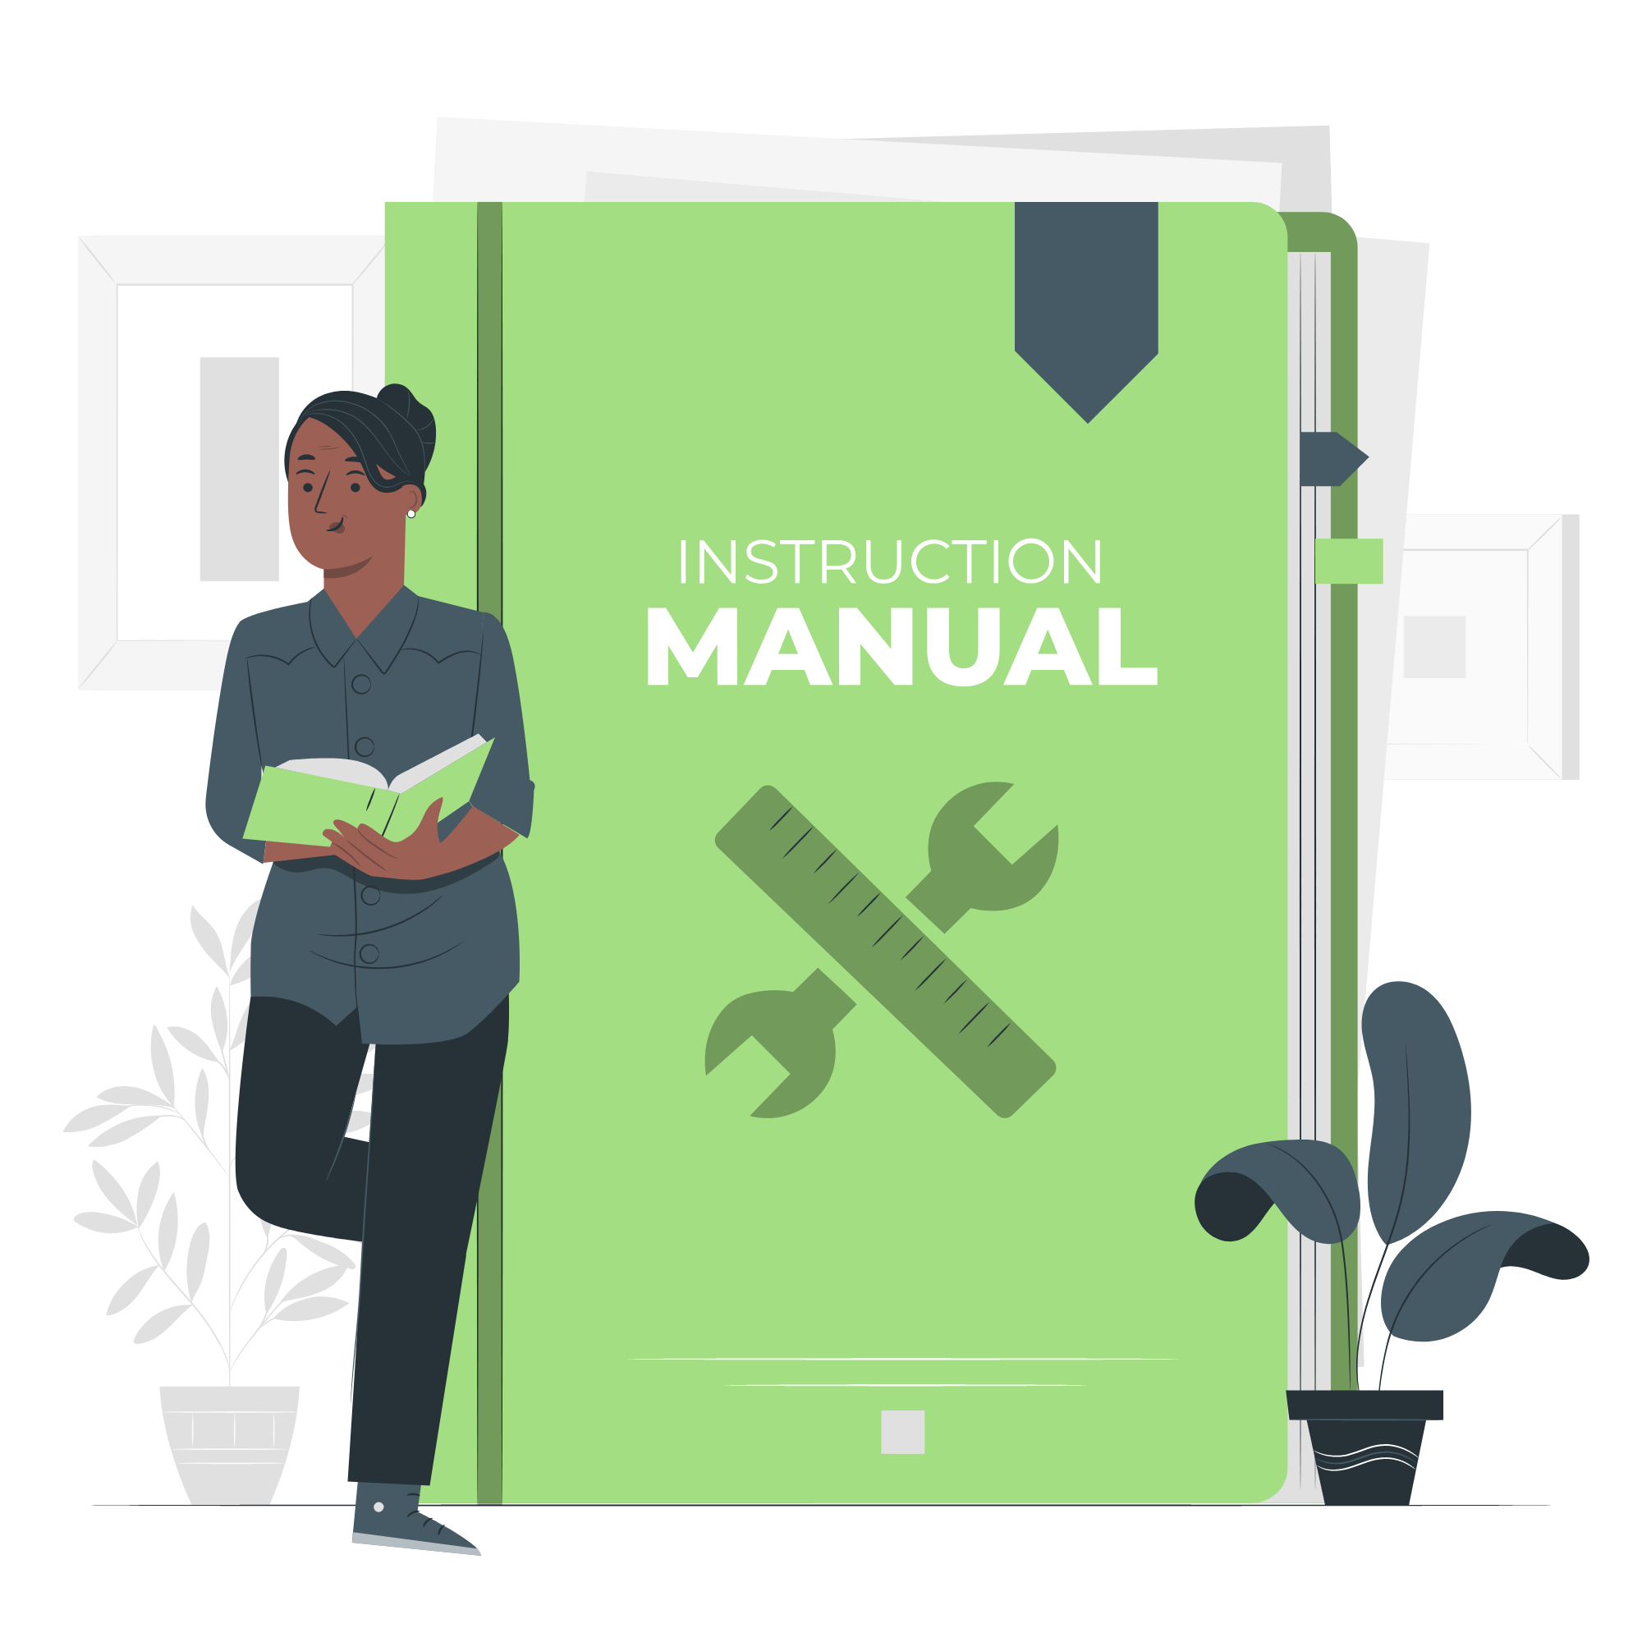
Good practices
Do not adopt the Black Hole date as your project submission date.
Focus on your curriculum and adapt your work so that you will not fall under 30 blackhole day.
Do not use A.G.U as a way to avoid blackhole.

Slide 11

Black hole and AGU
It might happen that some extreme event prevents you completely from attending your curriculum.
In such cases, 1337 core offers you a system to put your curriculum on hold and stop the Blackhole’s countdown.
The Anti Gravitational Units (A.G.U.s) or “freezes” as students tend to call them:
You have a maximum of 6 months worth of AGUs, that you can take in a maximum of 3 instances.
if you use an AGU slot it is consumed and cannot be suspended
A freeze will close all your accesses (intranet, building, computers, restauration, scholarship, access to campus etc.)

Slide 12

The first internship
Once the sevenths’ circle projects validated, you will need to apply for your first and mandatory internship, that once validated opens the possibility for you to get a proof of level.
NB: It could be generated any time if needed.
You have 2 options:
Generate it from the intranet, which will end your curriculum.
Ask it from bocal if you want to use it for a job or something else and want to continue your journey at 1337

Slide 13
02
Outer circle

Slide 14
While the Common Core focuses on fundamentals, the outer circle has been designed to provide our students with high expertise.
Students will face more challenging projects, in larger teams, and in a larger time scale. They will continue to learn by solving bigger problems!
The overall outer circle should last around 2 years including the internship.
This part of the curriculum will help you develop a neutrality towards technologies and languages in order to have adaptation skills of our students and help them avoid the fatal obsolescence that strikes the digital market over time.

Slide 15
03
Exits

Slide 16

Certification @ 1337
Once you validate the common core, you can work to either get:
Software Developer Certificate by reaching Level 16
IT Architect Expert Certificate by reaching Level 21
When you get a certificate, your curriculum stops, congratulations!
In the next slide, you will find a diagram the describes your journey briefly

Slide 17

Certification @ 1337 / 42 to Level 16
Internship 2
L16
Common core
Internship 1
L11 – to 13
Outer circle projects
L 14 *
Software developer Certificate
or
Outer circle projects
L 16
14 to 17 months
4 to 6 months
4 to 6 months
4 to 6 months
Level 16= End of studies
* before you start internship 2, it is highly recommended to be as close as possible to level 14.8 to reach level 16 after passing internship 2 without any additional project.

Slide 18
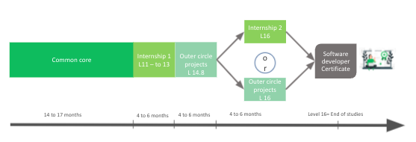
Certification @ 1337 / 42 to Level 21
Outer circle project
L 13 – to 20
Internship 2
L21
IT Architect Expert
Certificate
Level 21
=
End of studies
18 months
6 months

Slide 19
Life
@
1337

Slide 20
01
Support

Slide 21


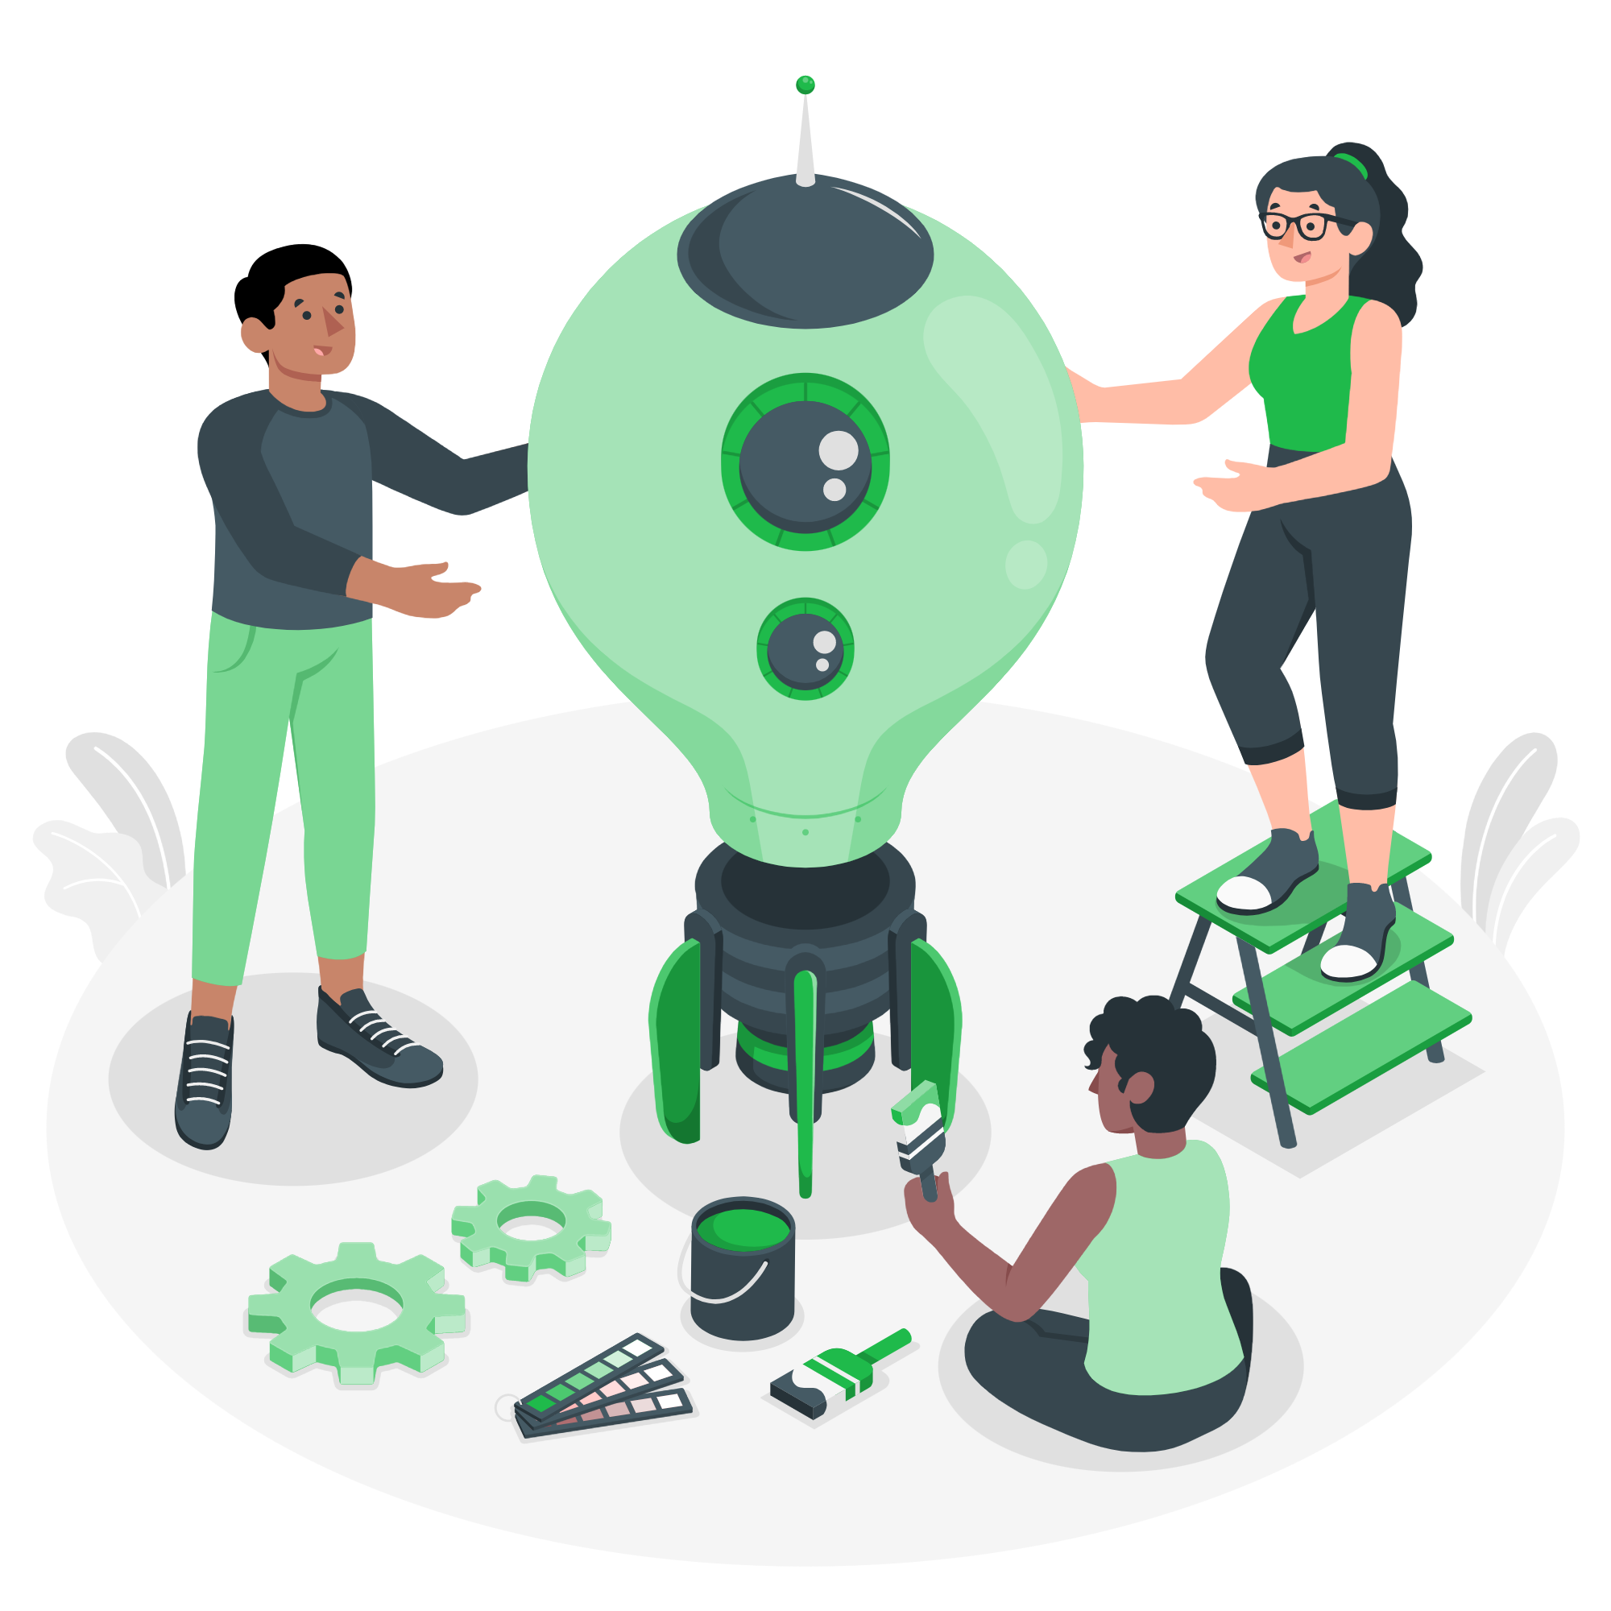
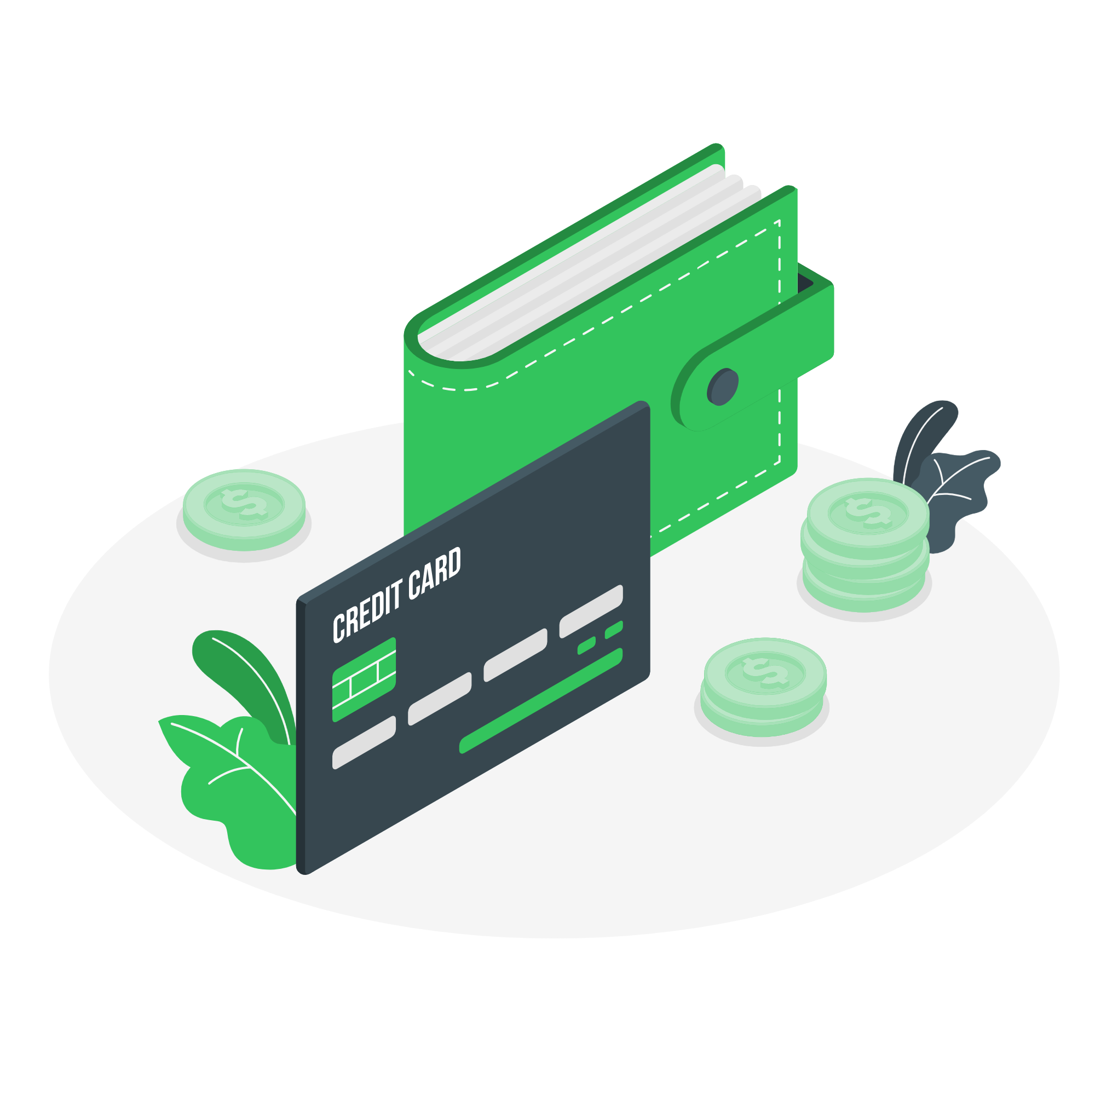
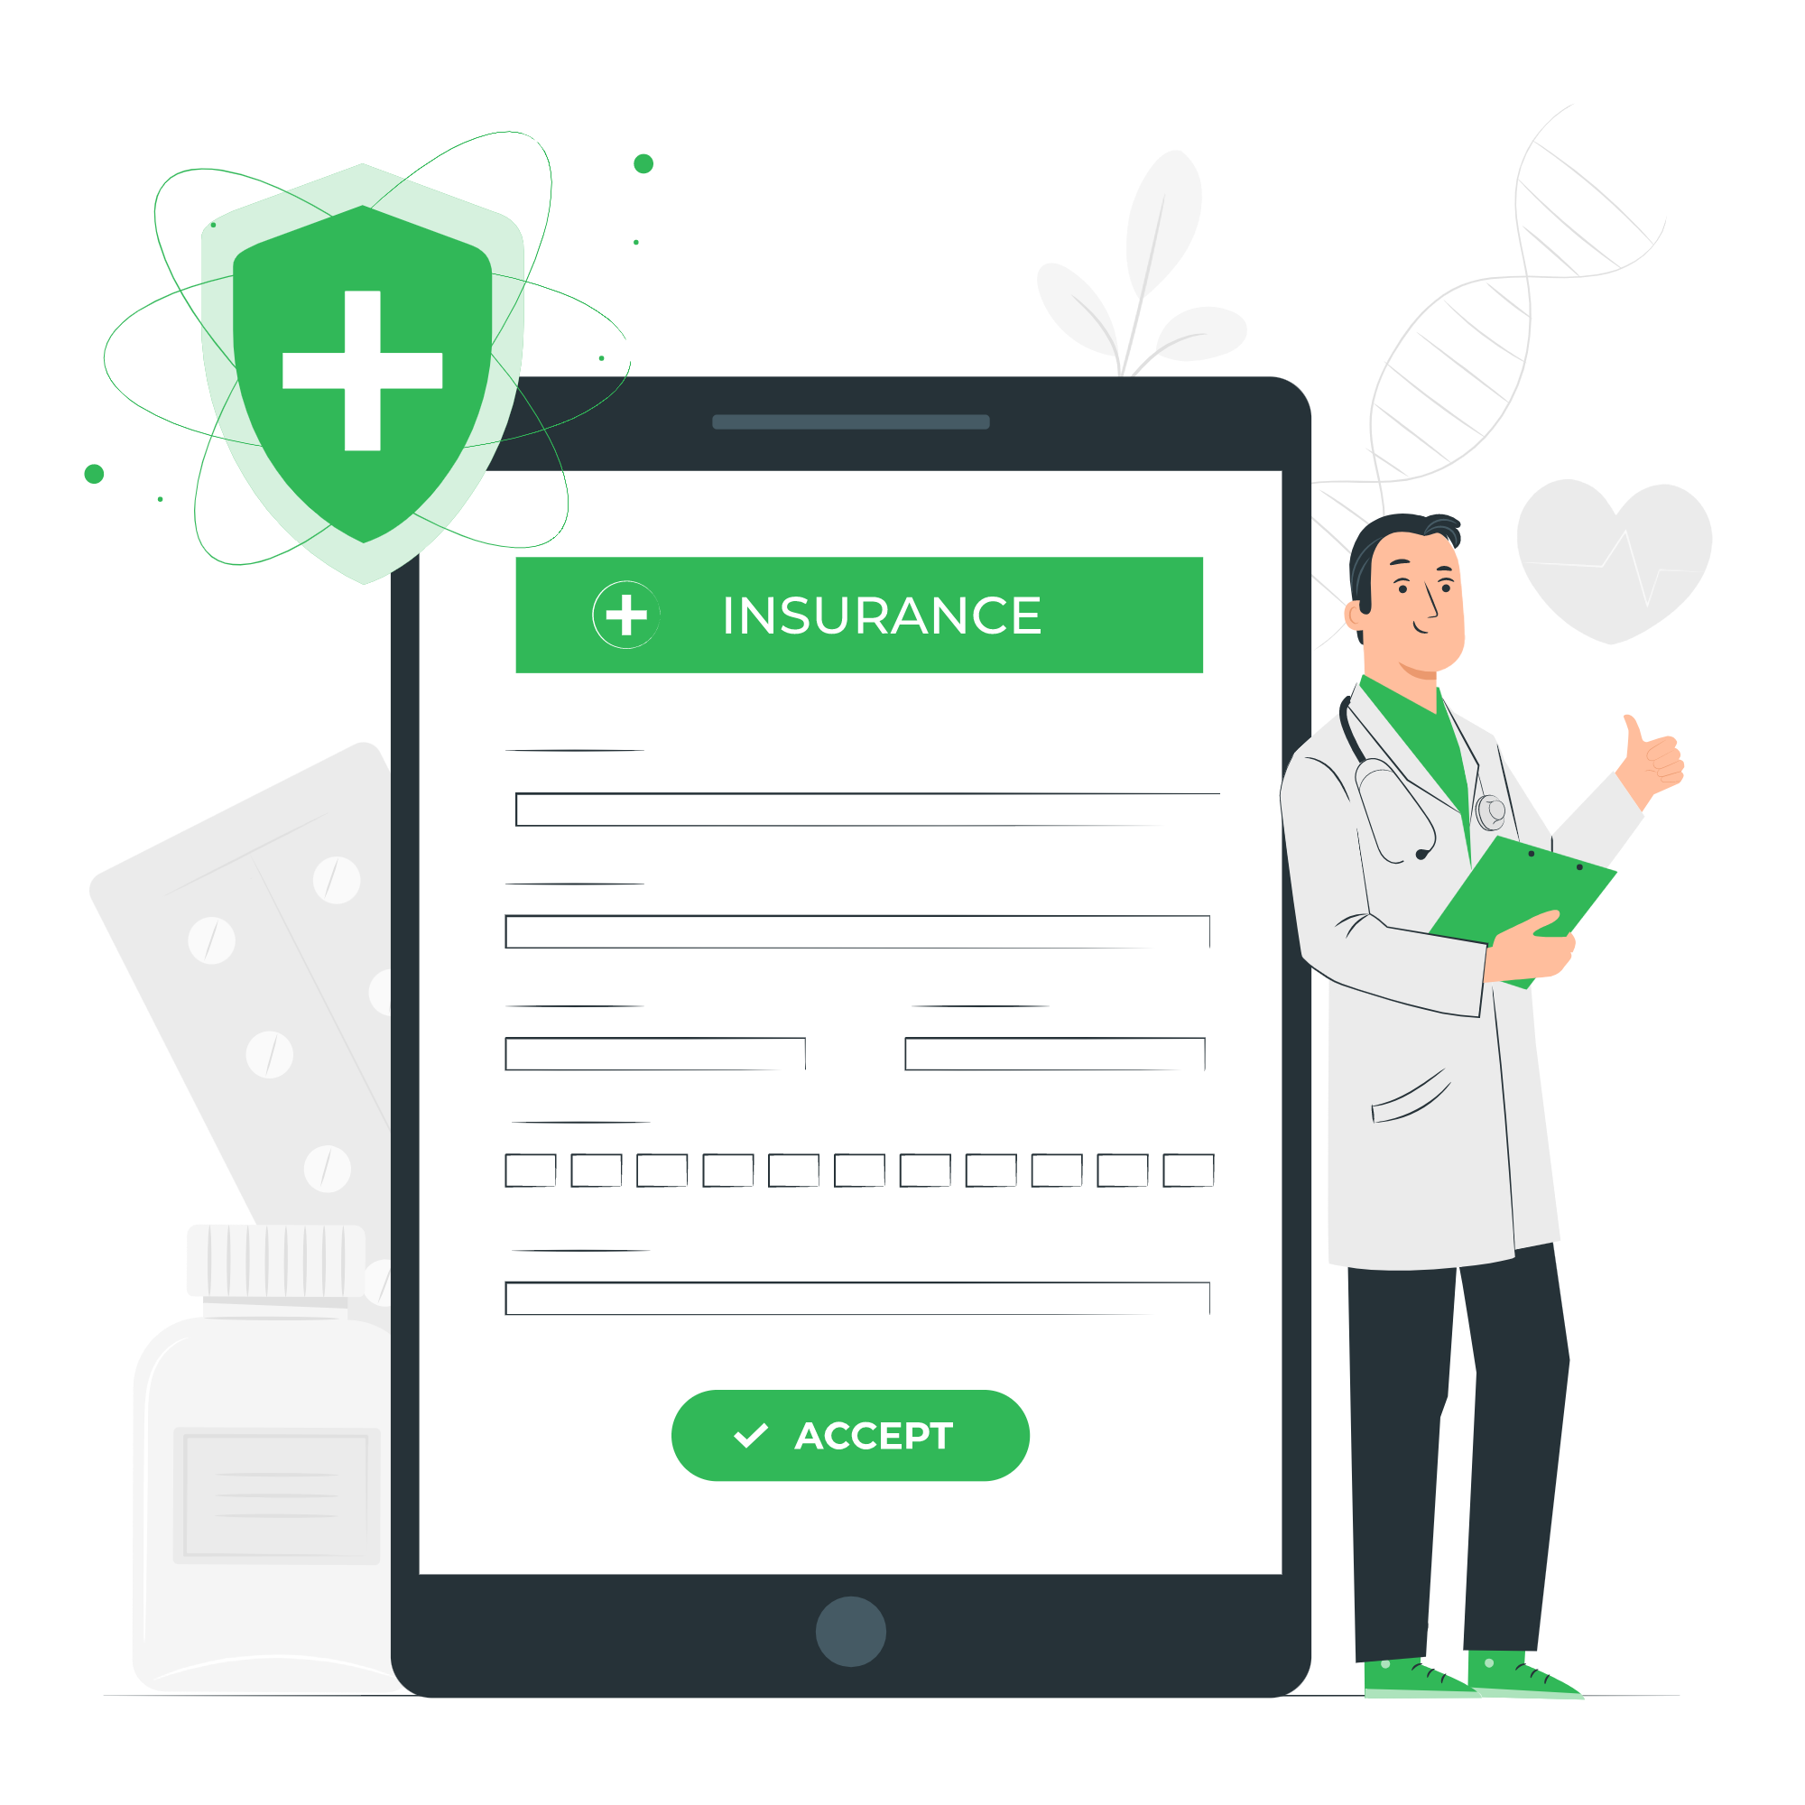
1337 provides you with many services to ensure your well being during the period of your studies! These services are However granted only when some conditions are met.
The time you spend studying at the school;
The progress located on the average zone

Slide 22
Scholarship
1337 grant scholarships to the eligible students to cover living expenses. So, you can focus on your studies. Otherwise, work for a living while studying may make it difficult for you to graduate on time, or even worse discontinue your higher studies.
The scholarships are available during common core curriculum and conditioned by some requirements: (min hours spent working on projects + keeping a good progress in common core curriculum
⇒ Overseer)
If you chose to continue your studies to the outer circle, scholarship will be extended for a max period of 4 months, until you reach level 14 where you get your Software Developer certificate after validating your Internship II
If you want to push things further and join the club of 10% you can benefit for another extended period in order to reach level 21.

Slide 23
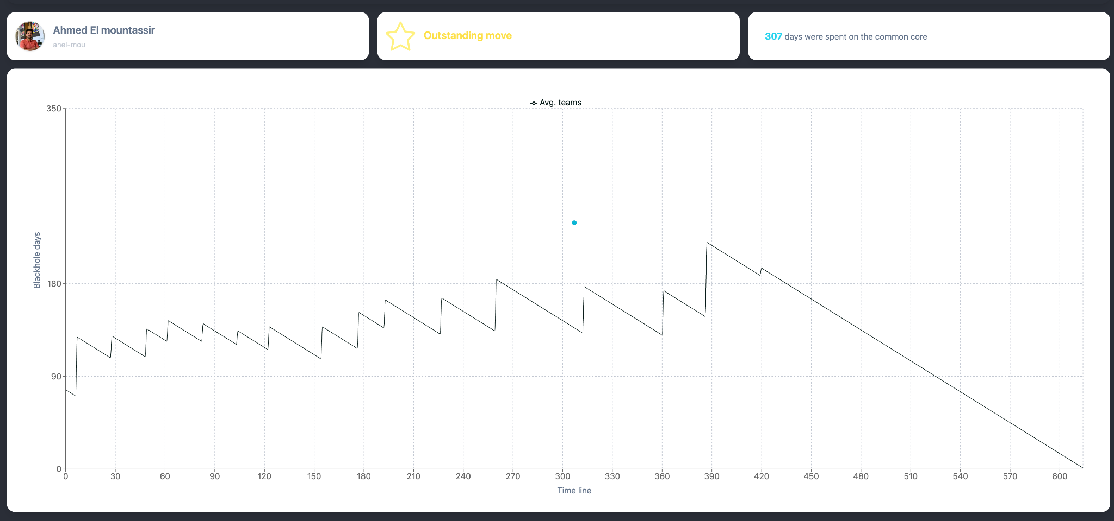
overseer

Slide 24
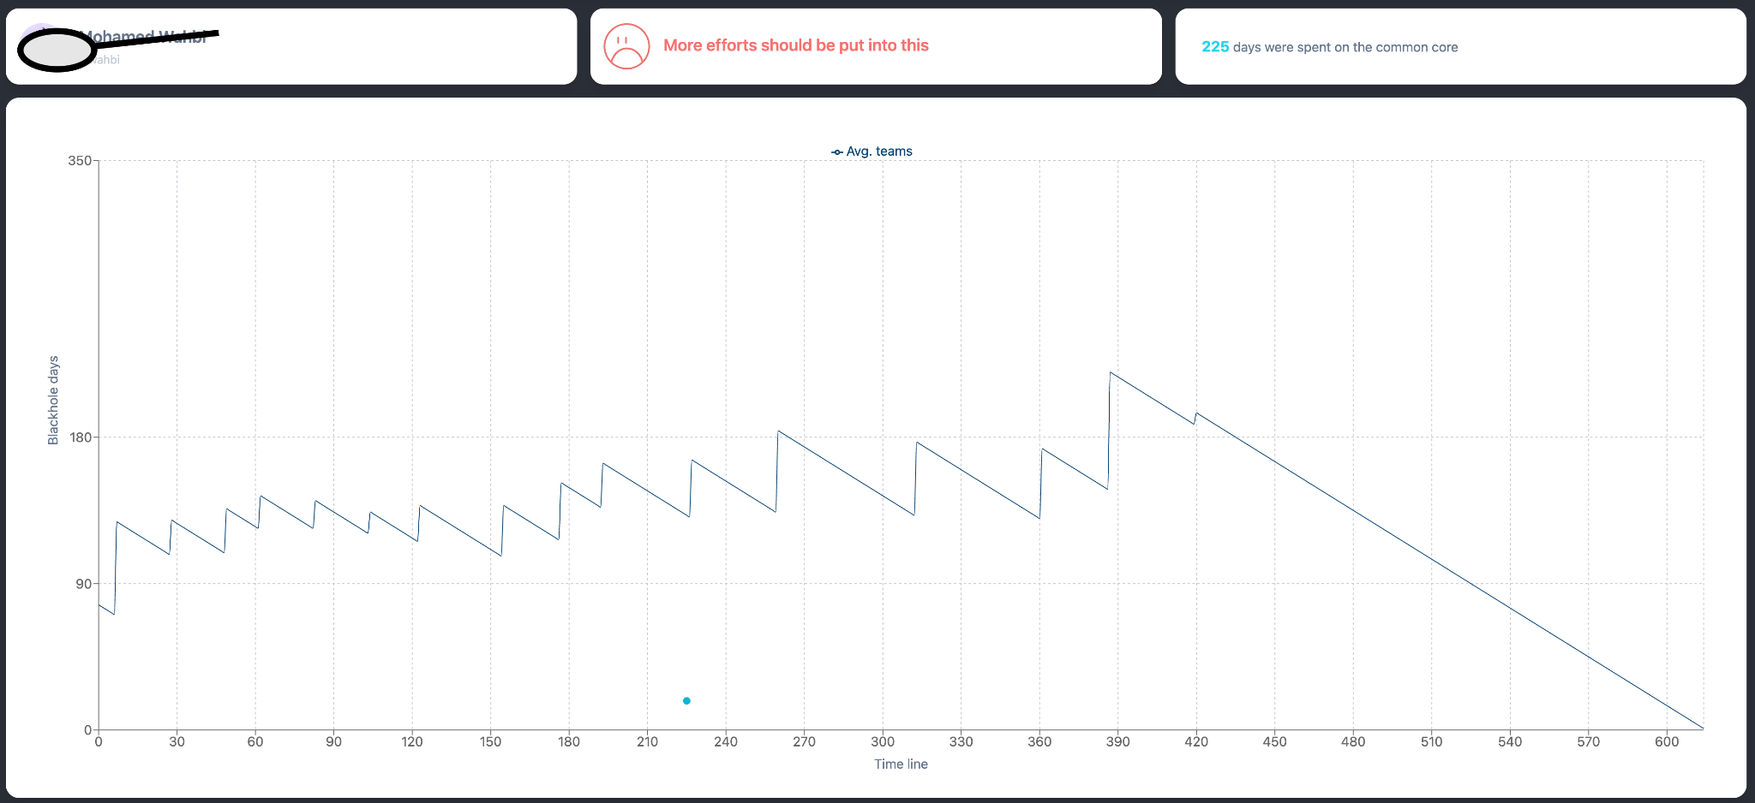


Slide 25
Other supports
Catering
Health insurance
Shuttle
We want you to focus on your curriculum and projects, but how can you do so on an empty stomach? That’s why meals are free at 1337.
In order to keep improving the catering, please don’t hesitate to share with us your feedback on (coming soon)
www.foodback.1337.ma
All 1337 students are affiliated to a health insurance, and they benefit from reimbursement of their medical expenses.
For more information, help or emergency please contact on Discord :
@Health Center for Khouribga Campus.
@Nawal: for Ben Guérir Campus.
@Sakina: for 1337 Med
To guarantee your security, 1337 set a night shuffle to take you home safely during night hours.
You will know quickly how it works

Slide 26
02
Activities

Slide 27

Start-Up
Interested in entrepreneurship?
1337 Labs is an innovation driven program that give start-ups an opportunity to work and collaborate, meet empowering like-minded community that puts startups first.
Those who are ready to commercialize their products/projects can get help, 1337 will lift the paperwork and administrative burden and can help you access some funding programs to kickstart your business.

Slide 28





Companies
We're proud to partner with companies and organizations not just for their hiring needs, but to change and impact the world. Companies recruit from us and are interested in how we can support their tech talent needs. More than that though, companies also find value in partnering with us on hackathons, projects and issuing challenges to our students and seeing how they solve problems. Our value doesn't just lie in hiring students; it's in how we think, learn, and solve.

Slide 29
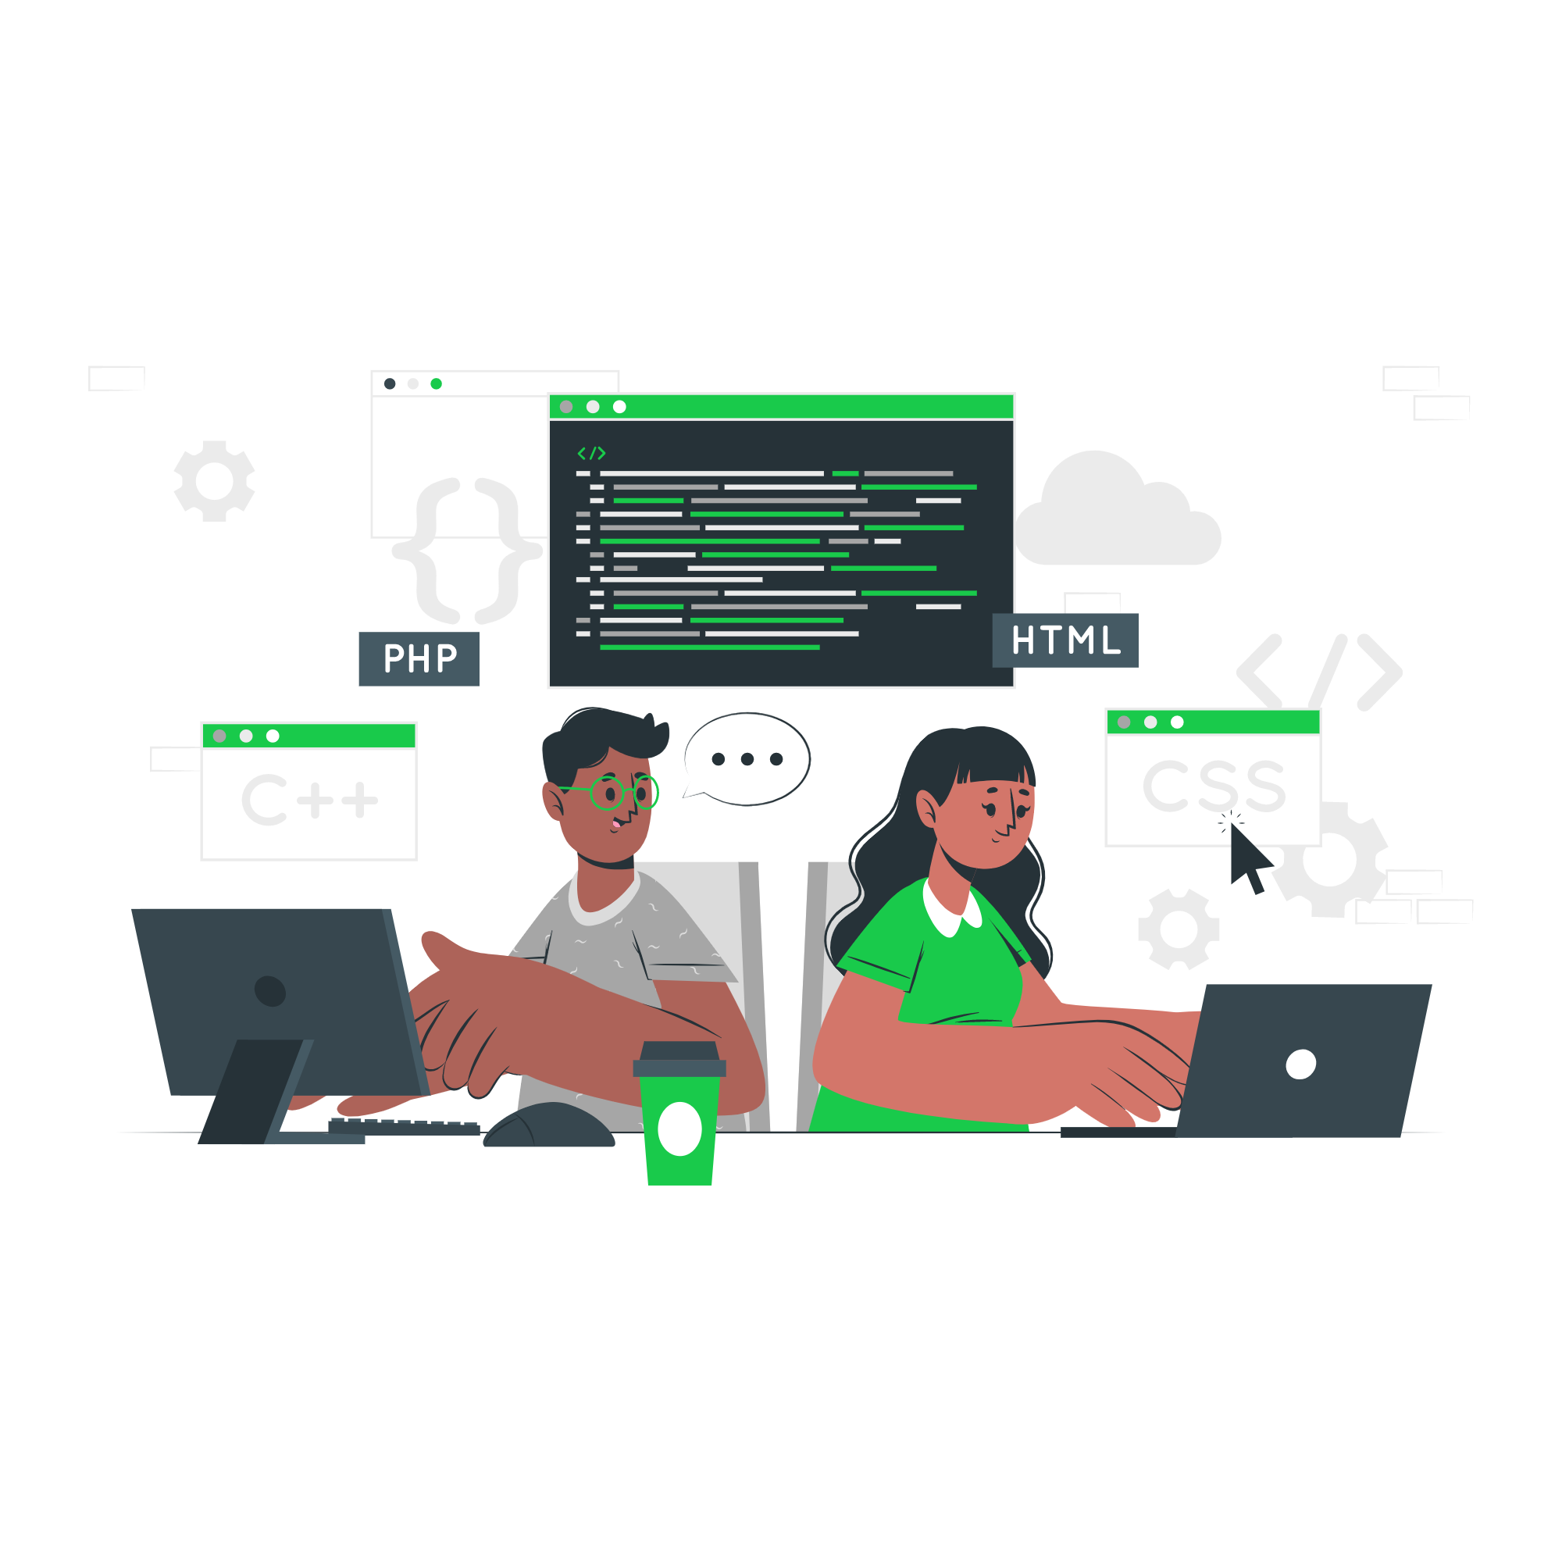
Competition
We're proud to serve the coding community and host hackathons and competitions throughout the year. Notable competitions include Moroccan Collegiate Programming Contest, Google Hashcode, Catch the Flag contests, Coding Game where everytime our students ranked pretty well.
Our students love taking on real-world challenges, and companies love having access to diverse tech talent. In the end, it's a win-win!

Slide 30

Meet Up
As always curious to know what's going on in the tech industry, we host networking events and meetups. As part of the tech community in Morocco, we love opening our doors to those who are just as excited about tech as we are. These events are a great way for our students to get involved in the local tech world and meet professionals, companies, experts.

Slide 31

Clubs
Our students are encouraged to create their own clubs, inboard to those who already created, and participate in a variety of events. To date, students have formed numerous clubs:
TWIL(This Week I Learned),
Robotics club,
Cyber security club,
1337- athleets,
1337 artificial intelligence
Communication club
and more...
Students have also organized several E-Sport tournaments featuring games such as Fifa, League of Legends, and Counter-Strike: GO.
So, we encourage you to join something, start something, make something, and invite others around you!

Slide 32
Life
@
Campus

Slide 33
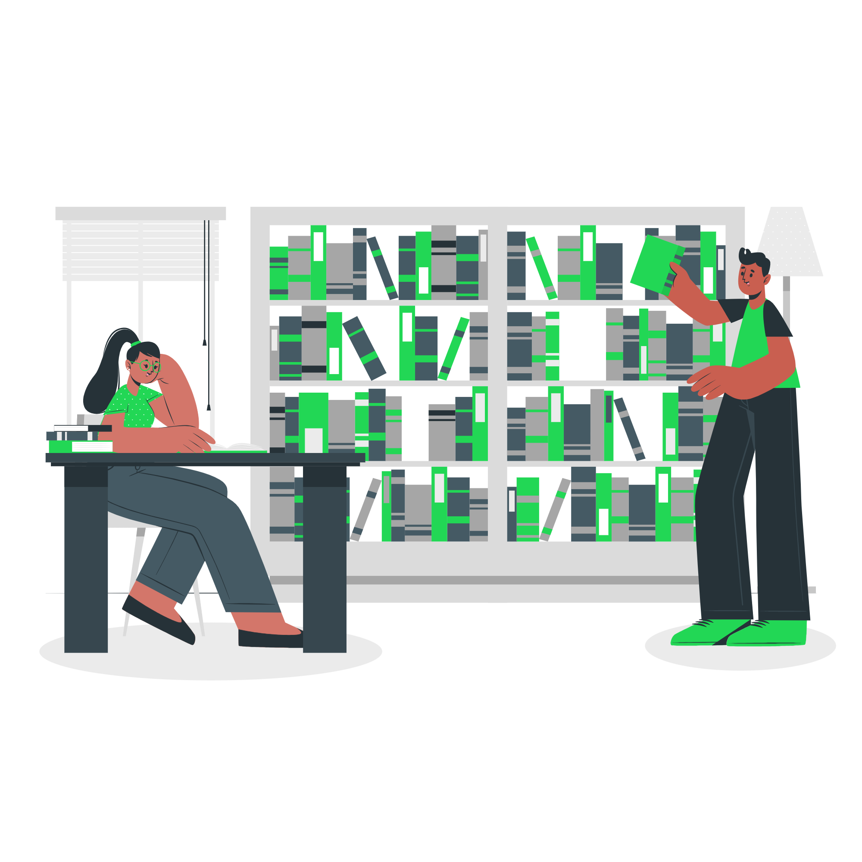
Library
Students can access and borrow books and magazines from one of the diversified libraries.
A local library will be deployed soon to encourage you to read. You are invited to enrich it with your favorite works and share them with your peers

Slide 34
Pôle Sport
Students could access to the amazing sport center where you can access to various activities. You can book your place in the link bellow
Our https://sport.um6p.ma/

Slide 35
Career center
Provide individualized support to students to build their professional project and enhance their skills (in line with the meaning they wish to give to their career, their own priorities and motivations) while developing their autonomy (actor and responsible for their development) and their self-confidence.

Slide 36
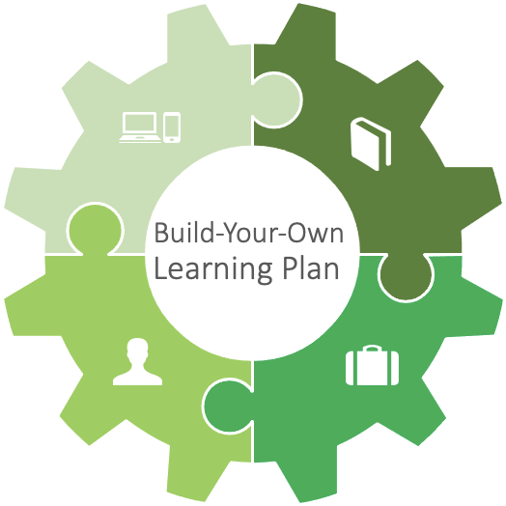
Language Lab
The UM6P Language Lab offers learning programs whose content that is tailored to industries, specific jobs (engineering, management, etc.), professional situations (public speaking, presentations, negotiations, business writing and social awareness), and finally successful completion of recognized international tests such as TOEIC, IELTS, DELF and DALF in several languages.
Content / Program racks
- General Language Programs
-Business Language Programs
-Content Based Learning (Academia, Industry Specific, etc:)
-Soft Skill Language Training (Public Speaking, Negotiations, Meetings & Presentations, etc.)
-Hard Skill Language Training (Scientific/ Technical writing, Business writing)
-Communication Training (Non-Violent Communication, Process Comm, MBTI, …)
Digital Solution
-Language Lab e-learning platform for self-study, flipped classrooms, interactive live classrooms and professional toolbox
-Virtual Classrooms
-MOOCs and SPOCs
-Digital Library (under development)
In Person Solution
-One –to-One Courses
-Open and Closed Group Courses
-Immersions (Domestic and Abroad)
-Summer Immersions Abroad for Teens
-Workshops and Conferences
-International/ Standardized Testing Center
Business Solution
-Translations
-Proofreading & Editing

Slide 37





S.O.L.E
Student Organizations, Leadership and Engagement (SOLE) envisions to improve student life and promote pride in belonging to UM6P.
Our main missions are to guarantee the success and autonomy of students by offering them innovative and collaborative learning opportunities, to explore their interests and to achieve their goals.
Student Activities
Student Jobs
Student Volunteering
Paid gigs at UM6P, getting professional experience as well as pocket money
Involving students in volunteering activities on a local, national, and international level.
Supporting extra-curricular activities to offer a conducive environment for students’ initiatives
UM6P Alumni
Student Success Center
Alumni network to create a strong link with the UM6P graduates and increase professional opportunities.
Improving UM6P’s environment to be more conducive to success. The center will offer peer-to-peer tutoring, and other services encouraging diversity and inclusion.

Slide 38
Thanks

